Slide 1
Neural Network and
Backpropagation Review
Natural Language Processing
(based on revision of Chris Manning Lectures)

Slide 2
Announcement
TA announcements (if any)...

Slide 3
Suggested Readings
Stanford matrix calculus notes
Stanford review of differential calculus
Stanford CS231n notes on network architectures
Stanford CS231n notes on backprop
Stanford derivatives, Backpropagation, and Vectorization
Learning Representations by Backpropagating Errors (seminal Rumelhart et al. backpropagation paper)

Slide 4
Name Entity Recognition

Slide 5
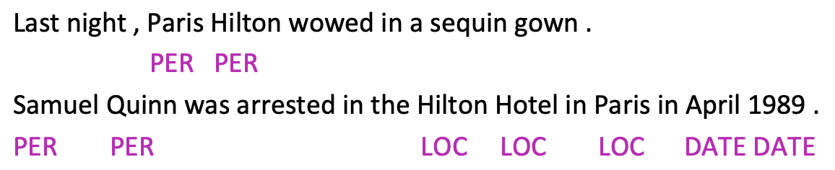
Named Entity Recognition (NER)
NER: find and classify names in text, for example:
Uses
Tracking mentions of particular entities in documents
For question-answering, answers are usually named entities
Often followed by Named Entity Linking/Canonicalization into Knowledge Base

Slide 6
Simple NER: Window classification using binary logistic classifier
Idea: classify each word in its context window of neighboring words
Train logistic classifier on hand-labeled data to classify center word {yes/no} for each class based on a concatenation of word vectors in a window
Example: Classify “Paris” as +/- LOC in context of sentence with window length 2:
the museums in Paris are amazing to see
X_{window} = [X_{museums} X_{in} X_{Paris} X_{are} X_{amazing}]^{T}
Resulting vector X_{window} ∈ R^{5d}, a column vector
To classify all words: run classifier for each class on vector on each word in the sentence

Slide 7
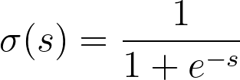





Simple NER: Window classification using binary logistic classifier
X_{window} = [X_{museums} X_{in} X_{Paris} X_{are} X_{amazing}]^{T}

Slide 8


Maximum Margin Objective Function
Let’s called the score computed for the “true” labeled window “Museums in Paris are amazing” as s where
Let’s called the score for “false” label window, e.g., “Not all museums in Paris” as s_{c} where
We want to maximize (s - s_{c}) or minimize (s_{c} - s)
We want to further ensure that error is only computed if s_{c} > s or s_{c} - s > 0. We only care that the “true” data point have higher score, thus, the objective function is min J = max(s_{c} - s, 0)
This is a big risky. To create a margin of safety, we want the “true” labeled data point to score higher than the “false” labeled data by some margin ∆. In other words, we want error to be (s - s_{c} < ∆). If the ∆ = 1, then the objective function is min J = max(1 + s_{c} - s, 0)

Slide 9
Matrix Calculus

Slide 10
Computing Gradients by Hand
Matrix calculus: Fully vectorized gradients
“Multivariable calculus is just like single-variable calculus if you use matrices”
Much faster and more useful than non-vectorized gradients
Support by NumPy and PyTorch
But doing a non-vectorized gradient can be good for intuition
Learning them allows you to deeply understand gradient-related problems, e.g., vanishing gradients

Slide 11
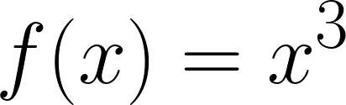
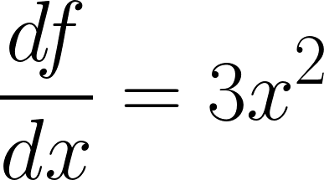
Gradients
Given a function with 1 output and 1 input
It’s gradient (slope) is its derivative
“How much will the output change if we change the input a bit?”
At x = 1, it changes about 3 times as much: 1.01³ = 1.03
At x = 4, it changes about 48 times as much: 4.01³ = 64.48

Slide 12
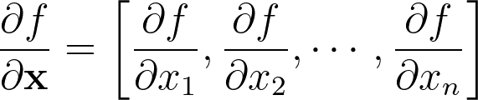
Gradients
Given a function with 1 output and n inputs
Its gradient is a vector of partial derivatives with respect to each input

Slide 13
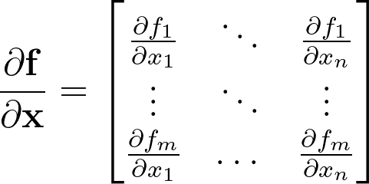
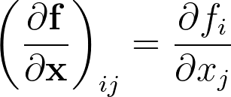
Jacobian Matrix: Generalization of the Gradient
Given a function with m outputs and n inputs
It’s Jacobian is an m x n matrix of partial derivatives

Slide 14

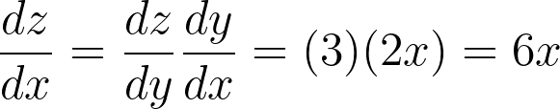

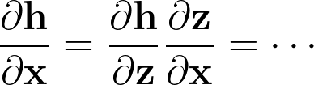


Chain Rule
For composition of one-variable function: multiply derivatives
For multiple variables at once: multiply Jacobians

Slide 15



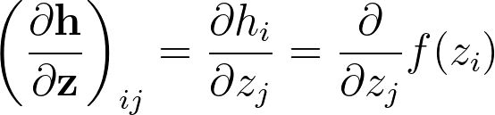
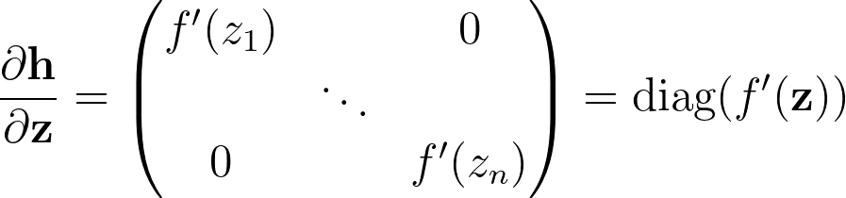
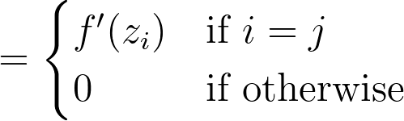
Example Jacobian: Elementwise activation function
what is
To figure it out, it’s useful to think about single-variable calculus
The derivative is simply:
Thus, if we take all derivatives:

Slide 16
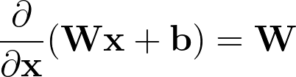
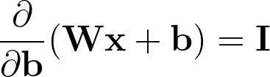
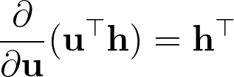
Other Jacobians

Slide 17

Back to our Neural Net!
Let’s find
X_{window} = [X_{museums} X_{in} X_{Paris} X_{are} X_{amazing}]^{T}

Slide 18
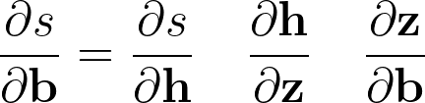





Apply the chain rule
Hadamard product (element wise product)

Slide 19

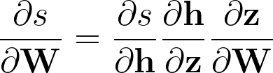
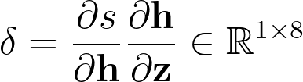
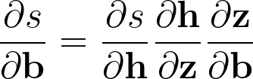
Re-using computation
Let’s find
Using the chain rule again:
is the local error signal
Let’s avoid duplicated computation…..

Slide 20


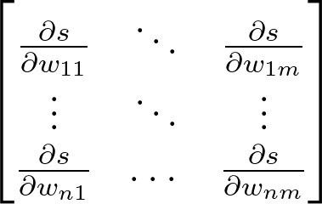
Derivative with respect to Matrix: Output shape
Let’s find look like?
1 output, nm inputs: 1 by nm Jacobian?
Inconvenient to perform gradient update
Instead, we use the shape convention, i.e., the shape of the gradient is the shape of the parameters
So is n by m:

Slide 21
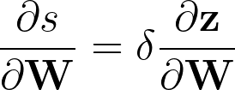
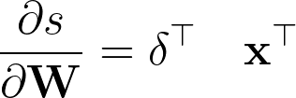



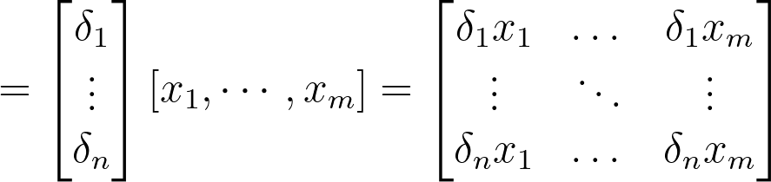
Derivative with respect to Matrix
Since thus, plugging what we have already learned, we get
Shape checking is a useful trick for checking your work!

Slide 22
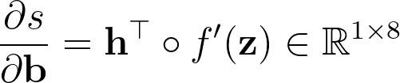
What shape should derivatives be?
Similarly is a row vector
But shape convention says our gradient should be a column vector because b is a column vector
Disagreement between Jacobian form (which makes the chain rule easy) and the shape convention (which makes implementation easy)
Always use shape convention
Use Jacobian form and then reshape to follow the shape convention at the end, e.g., here we simply perform a transpose should be enough to make this gradient a column vector.

Slide 23
Computation graphs and Backpropagation

Slide 24



Computation graphs and backpropagation
Software represents our neural network equations as graph
Why: reusing computations (which we hinted earlier)

Slide 25




Computation graphs and backpropagation
Then go backwards along edges
Pass along gradients

Slide 26

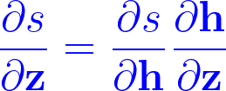
Backpropagation: Single node
Node receives an “upstream gradient”
Goal is to pass on the correct “downstream gradient”
[downstream gradient] = [upstream gradient] x [local gradient]
Each node has a local gradient
The gradient of its output with respect to its input
Downstream gradient
Local gradient
Upstream gradient

Slide 27
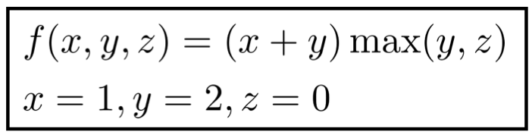
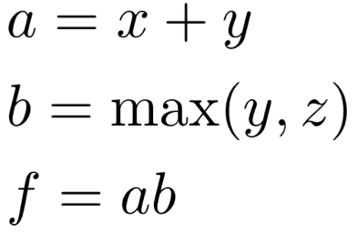



An Example
Forward prop steps
Local gradients
1
+
3
2
*
6
2
2
0
max

Slide 28
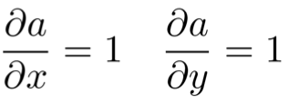
An Example
Forward prop steps
Local gradients
1
+
3
2
*
6
2
2
0
max

Slide 29
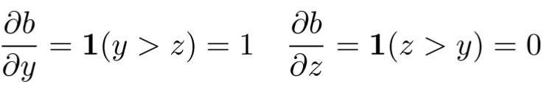
An Example
Forward prop steps
Local gradients
1
+
3
2
*
6
2
2
0
max

Slide 30
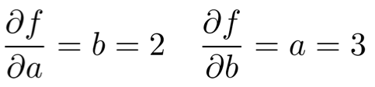
An Example
Forward prop steps
Local gradients
1
+
3
2
*
6
2
2
0
max

Slide 31
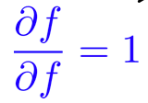
An Example
Forward prop steps
Local gradients
1
+
3
2
*
6
2
2
0
max

Slide 32
An Example
Forward prop steps
Local gradients
1
+
3
2
1 * 2 = 2
*
6
2
2
1
0
max
1 * 3 = 3
Upstream * local = downstream

Slide 33
An Example
Forward prop steps
Local gradients
1
+
3
2
2
*
6
2
2
1
3 * 1 = 3
0
max
3
Upstream * local = downstream
3 * 0 = 0

Slide 34
An Example
Forward prop steps
Local gradients
1
+
3
2 * 1 = 2
2
2
*
6
2 * 1 = 2
2
2
1
3
0
max
3
Upstream * local = downstream
0

Slide 35
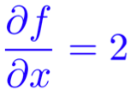
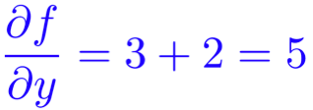
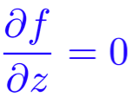
An Example
Forward prop steps
Local gradients
1
+
3
2
2
2
*
6
2
2
2
1
3
0
max
3
Upstream * local = downstream
0

Slide 36
Back-prop in general computation graph
Fprop: visit nodes in topological order
Compute accordingly
Bprop:
Initialize output gradient = 1
Visit nodes in reverse order
Pass along the gradients just like what we did
Done correctly, big O() complexity of fprop and bprop is the same
In PyTorch, everything is done for you!
So why study? Very useful for debugging or model development

Slide 37
Summary
Performing vectorized gradients are much faster and more useful than non-vectorized gradients
To understand, it’s useful to do single-variable calculus first
For chain rule, the derivatives are simply the multiplication of Jacobians
Always follow shape convention
That is, the gradient should be the same shape as the parameter itself
Maintaining gradients in graph form allows us to backprop efficiently
Good new: PyTorch already does that for you!

